Slide 1
Rethinking the verification pipeline
K. Rustan M. Leino
10 September 2026
IFIP WG 2.3 meeting #70
Southampton, UK

Slide 2
Verifier architecture
Source program
Translator
Semantic description
VC generator
VCs
Logic engine
Yes (and optionally a proof) or
No (and optionally a counterexample)
VC = Verification Condition

Slide 3
Verifier architecture
Source program
Translator
Boogie,
Why3,
Viper,
Coma,
B3,
…
IVL program
VC generator
VCs
Logic engine
Yes (and optionally a proof) or
No (and optionally a counterexample)
IVL = Intermediate Verification Language
VC = Verification Condition

Slide 4
Verifier architecture
Source program
Translator
IVL program
VC generator
VCs
SMT solver
Yes (and optionally a proof) or
No (and optionally a counterexample)
IVL = Intermediate Verification Language
VC = Verification Condition
SMT = Satisfiability Modulo Theories

Slide 5
Verifier architecture
Source program
Translator
IVL program
VC generator
First-order VCs
SMT solver
Yes (and optionally a proof) or
No (and optionally a counterexample)
IVL = Intermediate Verification Language
VC = Verification Condition
SMT = Satisfiability Modulo Theories

Slide 6
Things we treasure
Effective programming language
  Presents good concepts, methodology
  Syntactic consistency
  Familiar syntax
Readable specifications
  Abstraction, information hiding
Modular verification
IVL descriptions
  Stateful (x := e)
  Partial operations (assert)
  Nondeterminism (x := *)
  Partial statements (assume)
Verifier interaction at source level
Quick verifier turnaround
  First-order
  One-shot proofs

Slide 7
Or do we?
?
Effective programming language
  Presents good concepts, methodology
  Syntactic consistency
  Familiar syntax
Readable specifications
  Abstraction, information hiding
Modular verification
IVL descriptions
  Stateful (x := e)
  Partial operations (assert)
  Nondeterminism (x := *)
  Partial statements (assume)
Verifier interaction at source level
Quick verifier turnaround
  First-order
  One-shot proofs
✓
?
✗
?
?
✗
✗

Slide 8
Intermediate Verification Language
Thinking tool
  Helps you correctly define source-language semantics
Separates front-end (semantics) and back-end (logic engine)
💡Use functional language as IVL
  Executable semantics?
  Same/similar terms as in logic engine

Slide 9
State changes
if e {
x := 5
} else {
y := 7
}
z := x + y
let z :=
let (x, y) :=
if e then (5, y) else (x, 7)
in
x + y

Slide 10
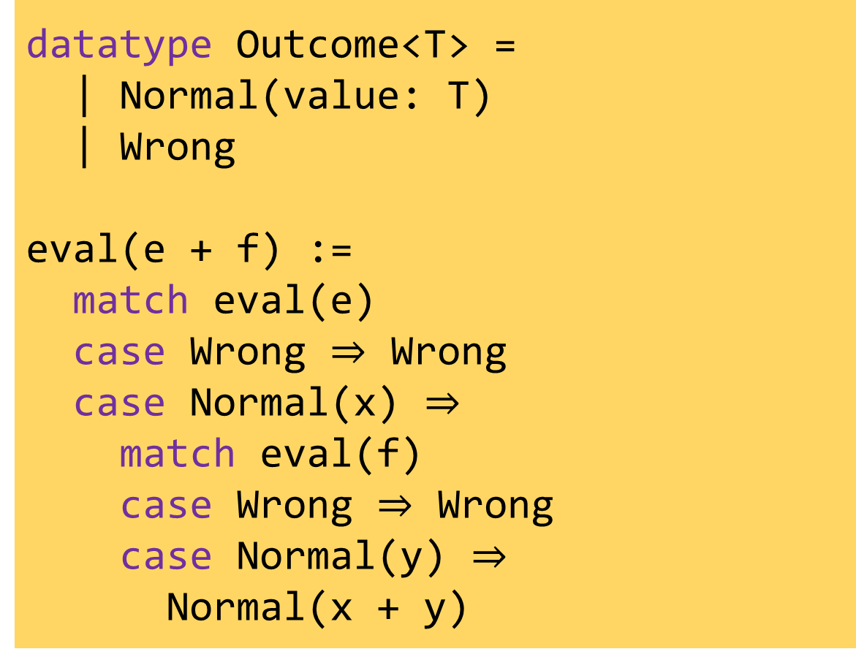
Proof obligations
assert wf⟦e⟧ ∧ wf⟦f⟧
r := e + f
datatype Outcome<T> =
| Normal(value: T)
| Wrong
eval(e + f) :=
match eval(e)
case Wrong $⇒$ Wrong
case Normal(x) $⇒$
match eval(f)
case Wrong $⇒$ Wrong
case Normal(y) $⇒$
Normal(x + y)

Slide 11
Nondeterminism
x := pick()

Slide 12
Nondeterminism
(x, st) := pick(st)

Slide 13
Memory allocation
p := new
(p, alloc) := (alloc, alloc + 1)

Slide 14
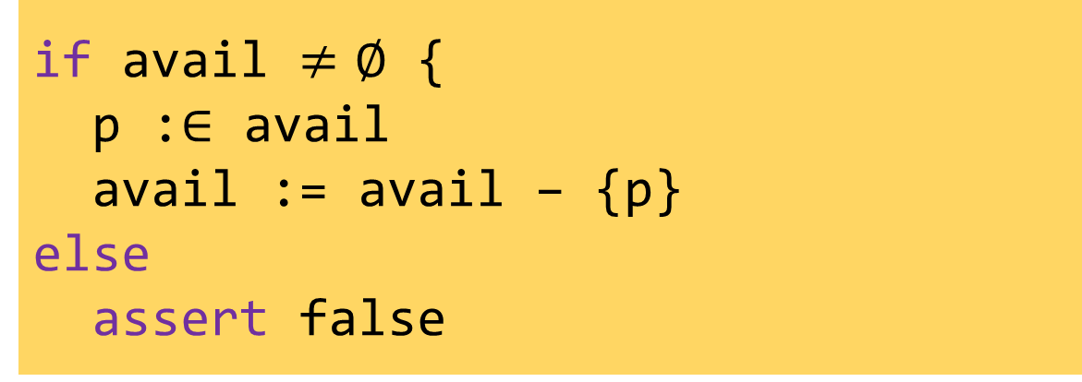
Memory allocation
p := new
if avail $≠∅$ {
p :$∈$ avail
avail := avail – {p}
else
assert false

Slide 15
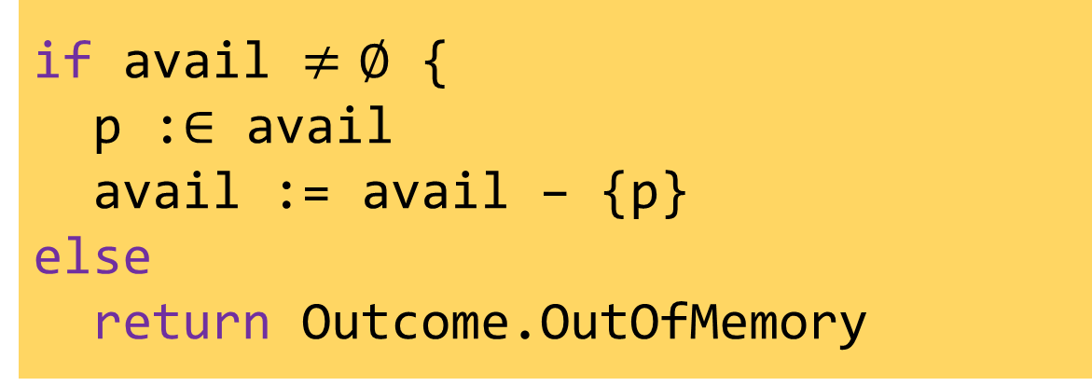
Memory allocation
p := new
if avail $≠∅$ {
p :$∈$ avail
avail := avail – {p}
else
return Outcome.OutOfMemory

Slide 16
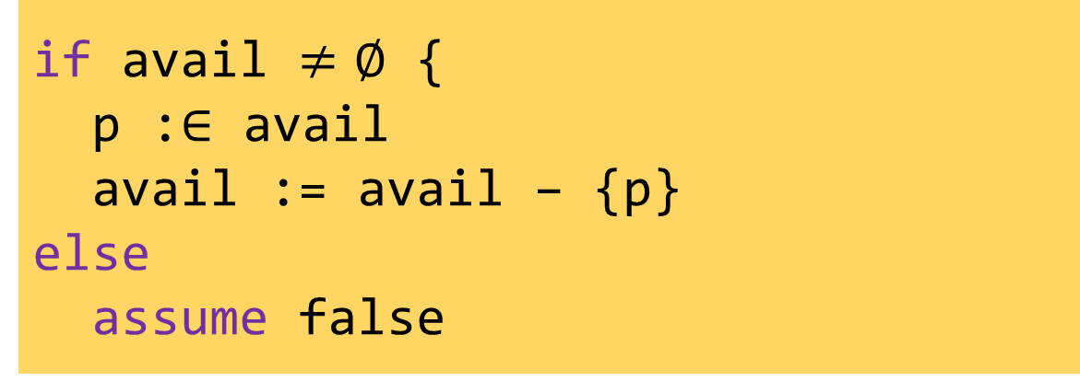
Memory allocation
p := new
if avail $≠∅$ {
p :$∈$ avail
avail := avail – {p}
else
assume false

Slide 17
Translating calc
calc {
E0;
== { Hint0 }
E1;
< { Hint1 }
E2;
}
Hint0
assert E0 == E1
assume false
[]
Hint1
assert E1 < E2
assume false
[]
assume E0 < E2

Slide 18
Loops without explicit fixpoint
loop
invariant J
{
Body
}
let x denote the variables
assigned to by Body
assert J
x := *
assume J
Body
assert J
assume false
Check the invariant on entry
Fast forward to an arbitrary loop iteration
Start in on the next iteration
Check invariant is maintained
Stop checking

Slide 19
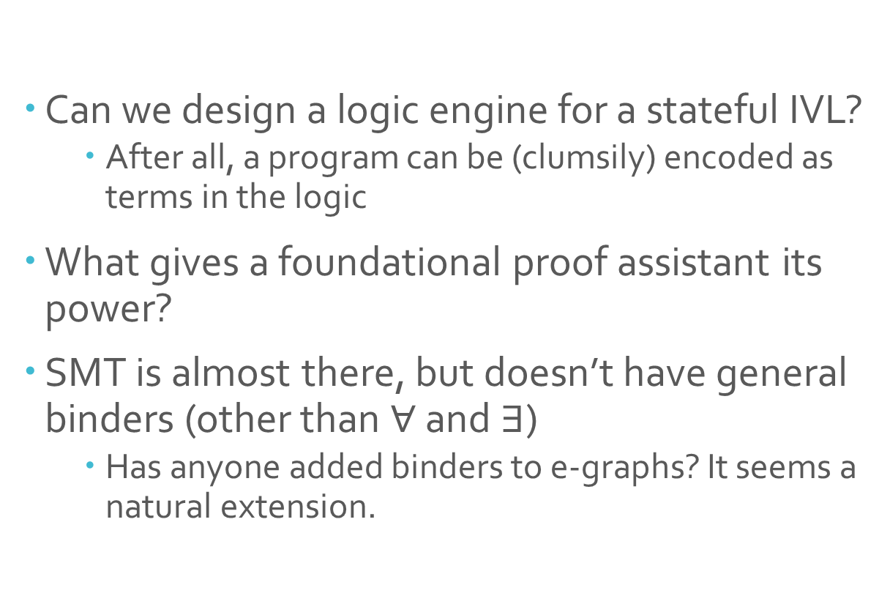
Logic engine
Can we design a logic engine for a stateful IVL?
  After all, a program can be (clumsily) encoded as terms in the logic
What gives a foundational proof assistant its power?
SMT is almost there, but doesn’t have general binders (other than $∀$ and $∃$)
  Has anyone added binders to e-graphs? It seems a natural extension.

